Slide 1


ACTION Teens
13% af sundhedsprofessionelle, der arbejder med overvægt internationalt, har 1 dags undervisning i overvægt.
Kasper Nørremark
Medical Manager - Obesity
Medical Affairs, Novo Nordisk Denmark A/S
Notes:
Awareness Care and Treatment in Obesity Management

Slide 2
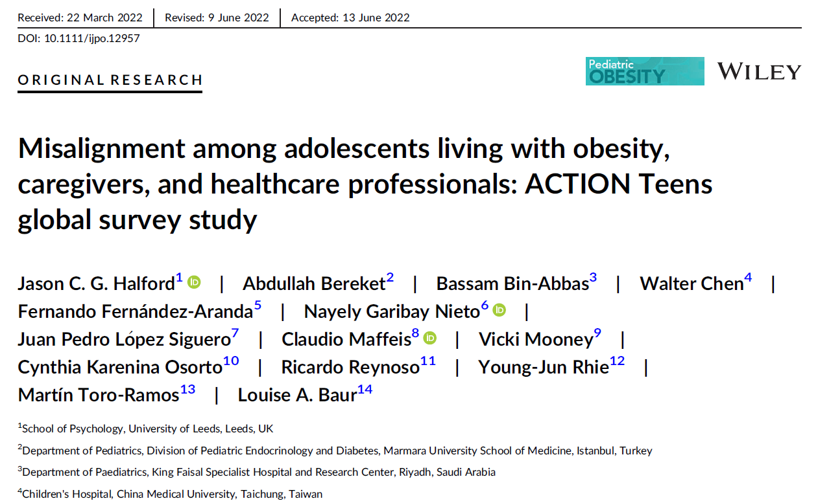
Baggrund og metode

Slide 3

Kamp imod vægten som ung er associeret med sværere grad af overvægt og hjælpeløshed
Tidlig svær overvægt (<20 år) var associeret med:
  Højere BMI senere i livet
  Flere vægttabsforsøg
  Mindre successfulde vægttabsforsøg
  Mere hjælpeløshed
Andel af patienter med svær overvægt, %
Fastholdt vægttab på mindste 5% i mindst 1 år*
Tidlig svær overvægt <20 år
(n=4,045)
Senere svær overvægt ≥20 år
(n=10,457)
Coutinho W et al. ECO ICO Sept 2020, Abstract discussion AD10-02. Data from ACTION IO study.
*For how long would you say you’ve been able to maintain your weight loss?
†Which of the following best describes how your weight changed over time?
BMI, body mass index.
Notes:
Data from ACTION IO study

Slide 4
Rationale for ACTION teens study
There is limited research available regarding the experiences, challenges, and needs of adolescents living with obesity (ALwO), their caregivers (CG) and the healthcare providers (HCPs) that treat them
Previous, smaller studies have found conflicting perceptions of weight management issues between ALwO and their mothers and misalignment regarding obesity care and management
There is a tendency for parents/caregivers to underestimate the overweight status of their child, potentially hindering effective management of ALwO
Roberts KJ, Hafez SA, Snethen J, Binns HJ, Knafl KA. Perceptions of weight management: interviews with adolescents with severe obesity and their mothers. Child Obes. 2021; Alshahrani A, Shuweihdi F, Swift J, Avery A. Underestimation of overweight weight status in children and adolescents aged 0-19 years. a systematic review and meta-analysis. Obes Sci Pract. 2021;7(6):760-796; Ramos Salas X, Buoncristiano M, Williams J, et al. Parental perceptions of children's weight status in 22 countries: the WHO European Childhood Obesity Surveillance Initiative: COSI 2015/2017. Obes Facts. 2021;14(6):658-674.

Slide 5


ACTION teens er et international spørgsekemabaseret studie udført i 10 lande
Det første studie der skal undersøge barrierer for god behandling af svær overvægt set fra:
Unge mennesker der lever med svær overvægt (ALwO)
Pårørende (Caregivers)
Sundhedsprofessionelle (HCPs)
ALwOs
Pårørende
HCPs
ACTION teens studiet er støttet af Novo Nordisk
ALwO, adolescents living with obesity; HCP, healthcare professional.
Halford et al. Pediatric Obesity. 2022;e12957. doi:10.1111/ijpo.12957.

Slide 6
Deltagere og inklusionskriterier
ALwO
5,275
Pårørende
5,389
HCPs
2,323
Unge 12–17-årige med svær overvægt
Svær overvægt svarende til aldersspecifik BMI lig eller større end 95 percentilen for køn og alder (iso-BMI ≥ 30 kg/m²).
  Pårørende til unge med svær overvægt
  Bor under samme tag som
  ALwO mindst 50% af tiden.
  Involveret i beslutninger om sundhed for den unge.
  Sundhedsprofessionelle
Alment praktiserende læger og andre, der bl.a. arbejder med unge med svær overvægt.
Specialister i børne- og unge- overvægt.
Skal se et minimum af unge (12-17-årige) dagligt
BMI was calculated based on self-reported height and weight. Percentile for age and sex was based on locally appropriate charts for the country of residence.
ALwO, adolescents living with obesity; HCP, healthcare professional.
Halford et al. Pediatric Obesity. 2022;e12957. doi:10.1111/ijpo.12957.
Notes:
Exclusion criteria: ALwO (and consequently their caregivers) were excluded if:
they had significant weight loss/gain due to major injury/illness in the past 6 months
during screening that they considered themself (or their child) to be “extremely muscular”

Slide 7



Sundhed og helbred
Interaktioner med sundhedsprof.
Samtaler om vægttab og motivation
Svær overvægts indflydelse
Informations- kilder
Holdninger om overvægt og mad
Sociodemografi
Notes:
Prior to the launch of the quantitative surveys, there was one round of pre-testing;
60-minute web-assisted pre-test interviews were conducted with four ALwO, four caregivers of ALwO, and four HCPs (two each of primary care providers and specialists) in each country. Participants involved in the pre-testing process were screened using the same screening criteria used for the overall sample population, thus their demographics were similar to the overall sample

Slide 8
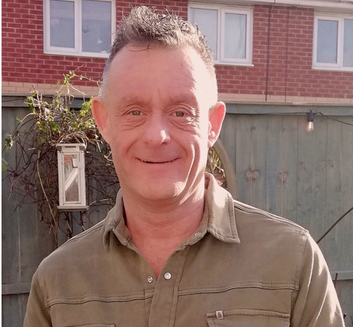

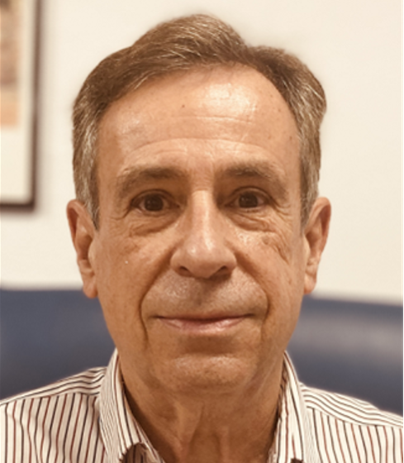

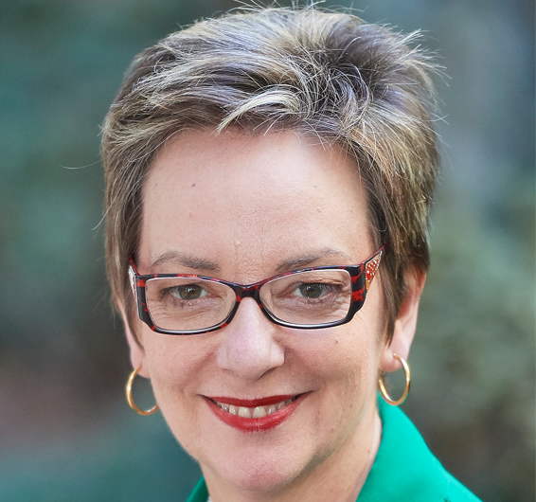

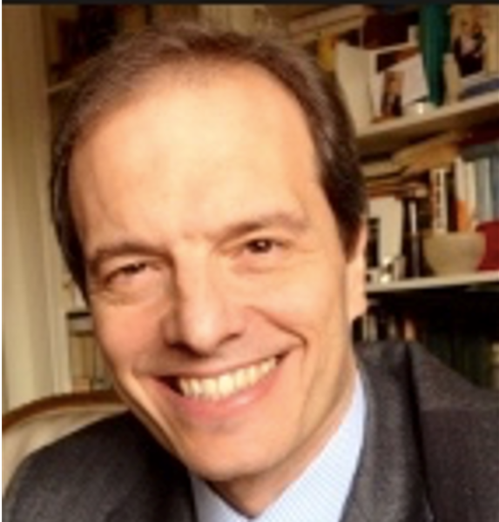

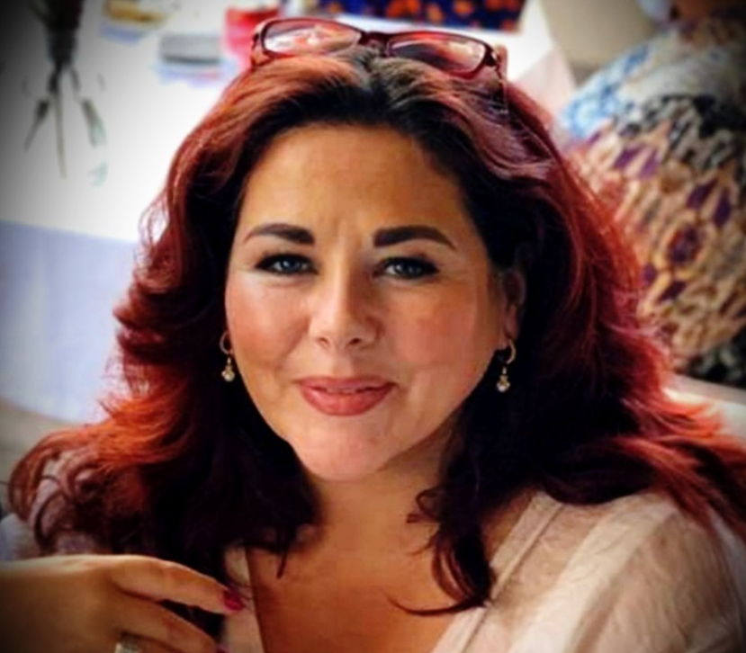

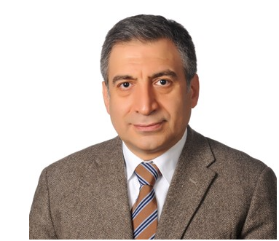

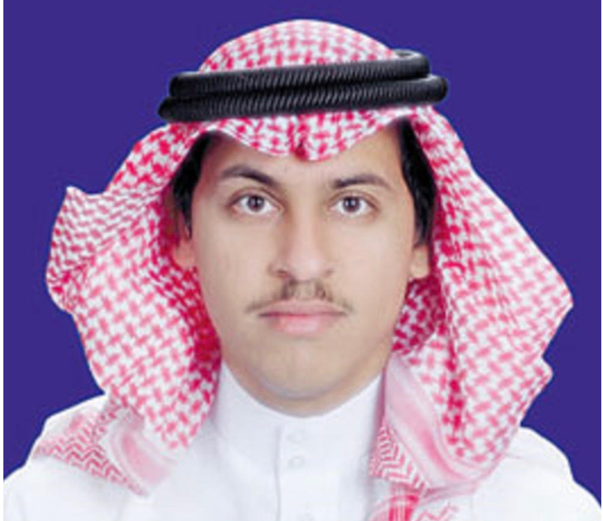
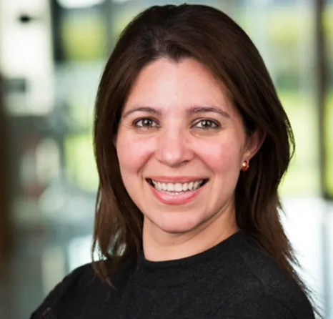



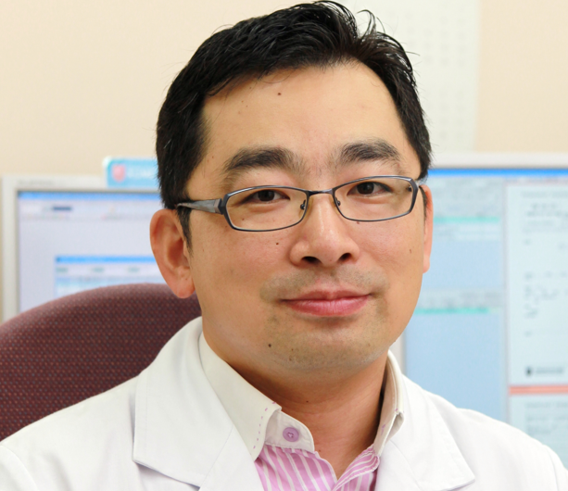

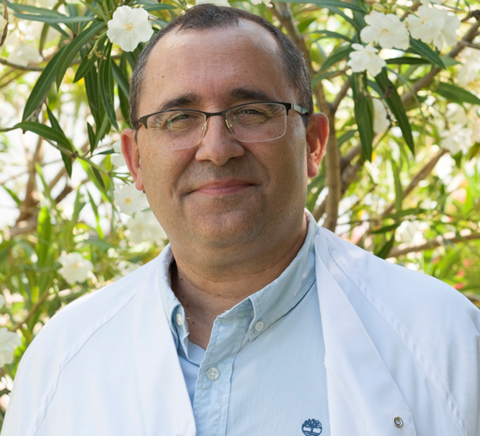
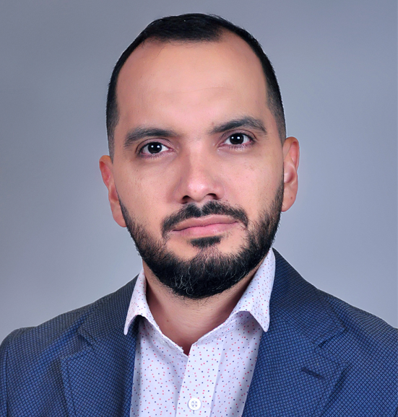

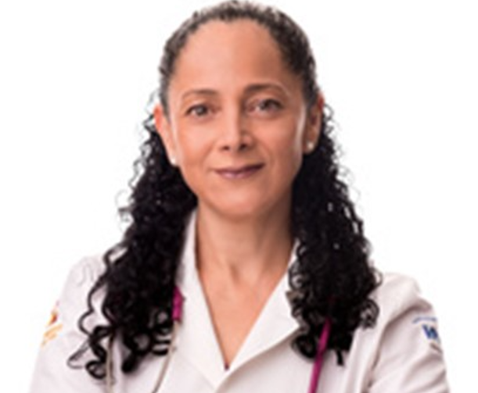


Styrekomite medlemmer
Prof. Jason Halford
Co-chair
United Kingdom
Prof. Juan Pedro Lopez Siguero
Spain
Dr. Louise Baur
Australia
Prof. Claudio Maffeis
Italy
Dr. Abdullah Bereket
Turkey
Ms. Vicki Mooney
EASO EPSO
Dr. Bassam Bin-Abbas
Saudi Arabia
Cynthia Osorto Contreras, MD
Novo Nordisk
Dr. Walter Chen
Taiwan
Prof. Young-Jun Rhie
South Korea
Dr. Fernando Fernández-Aranda
Spain
Dr. Martin Toro
Colombia
Dr. Guadalupe Nayeli Garibay Nieto
Mexico
Ricardo Reynoso Mendoza, MD
Co-chair
Novo Nordisk

Slide 9
Deltagende lande
United Kingdom
Italy
Spain
South Korea
Turkey
Mexico
Taiwan
Saudi Arabia
Colombia
Australia

Slide 10
Resultater

Slide 11
ALwO karakteristika
 |  | ALwO (n=5,275)
Køn | Drenge | 56%
 | Piger | 44%
Alder (år) | Gennemsnit (SD) | 14.8 (1.7)
Overvægtsklasse
Besvaret af ALwO
Overvægtsklasse for ALwO Besvaret af pårørende
ALwO, adolescents living with obesity; BMI, body mass index; SD, standard deviation.
Halford et al. Pediatric Obesity. 2022;e12957. doi:10.1111/ijpo.12957.

Slide 12
Sundhedsprofessionelles specialer og tilknytning
Primær sektor læge
(57%)
Sekundær sector læge
(23%)
Percentages are proportions of participants among all recruited HCPs (n=2323). HCPs selected their primary medical specialty from a list of prespecified response options; specialties were subsequently classified into three overarching categories (primary care practitioner, general paediatrician, other specialty).
HCP, healthcare professional. Halford et al. Pediatric Obesity. 2022;e12957. doi:10.1111/ijpo.12957.

Slide 13
Uddannelse af sundhedsprofessionelle i overvægt
Selvrapporteret speficik uddannelse om svær overvægt og håndtering af samme – ud over på medicinstudiet
Andel af HCPer (%)
Percentages are proportions of participants among all recruited HCPs (n=2323).
ALwO, adolescents living with obesity; HCP, healthcare professional.
Halford et al. Pediatric Obesity. 2022;e12957. doi:10.1111/ijpo.12957.

Slide 14
Informationskilder til at lære om svær overvægt, sund livsstil, vægttab og vægtfastholdelse
ALwO (n=5,275)
Pårørende (n=5,389)
HCPs (n=2,323)
Select responses are presented.
ALwO, adolescents living with obesity; HCP, healthcare professional; CMR: Continued Medical Education
Halford et al. Pediatric Obesity. 2022;e12957. doi:10.1111/ijpo.12957.

Slide 15
Opfattet indflydelse af svær overvægt
Andel af respondenter, der opfatter svær overvægt som havende stor/meget stor indflydelse på en persons overordnede helbred og velvære.
72%
67%
89%
ALwO (n=5,275)
Pårørende (n=5,389)
All HCPs (n=2,323)
ALwO, adolescents living with obesity; HCP, healthcare professional.
Halford et al. Pediatric Obesity. 2022;e12957. doi:10.1111/ijpo.12957.

Slide 16
Opfattet byrde af svær overvægt hos den unge (1)
Opfattelse af den unges vægt
Opfattelse af den unges overordnede helbred
ALwO (n=5,275)
Pårørende (n=5,389)
ALwO (n=5,275)
Pårørende (n=5,389)
76%
Above normal
66%
Above
normal
71%
Positive
80%
Positive
ALwO, adolescents living with obesity.
Halford et al. Pediatric Obesity. 2022;e12957. doi:10.1111/ijpo.12957.

Slide 17
Opfattet byrde af svær overvægt hos den unge (2)
Den unges bekymring om (over)vægt
Bekymring om den unges (over)vægts indflydelse på fremtidigt helbred/sundhed
ALwO (n=5,275)
Pårørende (n=5,389)
ALwO (n=5,275)
Pårørende (n=5,389)
60%
Worried
72%
Worried
86%
Worried
80%
Worried
40%
Not worried
20%
Not worried
28%
Not worried
15%
Not worried
ALwO, adolescents living with obesity.
Halford et al. Pediatric Obesity. 2022;e12957. doi:10.1111/ijpo.12957.

Slide 18
Holdninger om vægttab
Percentage of respondents
ALwO (n=5,275)
Pårørende (n=5,389)
ALwO, adolescents living with obesity.
Halford et al. Pediatric Obesity. 2022;e12957. doi:10.1111/ijpo.12957.

Slide 19
Den unges vægttabsforsøg
Andel af ALwO der forsøgt at få et vægttab i det forgange år.
Sandsynligheden for at forsøge et vægttabsforløb i løbet af de næste 6 måneder.
ALwO (n=5,275)
Pårørende (n=5,389)
ALwO (n=5,275)
Pårørende (n=5,389)
ALwO, adolescents living with obesity.
Halford et al. Pediatric Obesity. 2022;e12957. doi:10.1111/ijpo.12957.

Slide 20
Motivation for den unges vægttab
ALwO (n=5,275)
Pårørende (n=5,389)
All HCPs (n=2,323)
Andel af respondenter
Andel af respondenter
Select responses are presented.
ALwO, adolescents living with obesity; HCP, healthcare professional.
Halford et al. Pediatric Obesity. 2022;e12957. doi:10.1111/ijpo.12957.

Slide 21
Barrierer for den unges vægttab
ALwO (n=5,275)
Pårørende (n=5,389)
All HCPs (n=2,323)
Andel af respondenter
Andel af respondenter
Select responses are presented.
ALwO, adolescents living with obesity; HCP, healthcare professional.
Halford et al. Pediatric Obesity. 2022;e12957. doi:10.1111/ijpo.12957.

Slide 22
Initiatering af samtale om vægt imellem den unge og den sundhedsprofessionelle
Person who
initiated discussions
ALwO who had
discussed weight (n=3,264)
Caregivers who had
discussed weight (n=3,329)
All HCPs (n=2,323)
Percentage of respondents
Percentage of respondents
Percentage of respondents
Person who should initiate discussions
ALwO (n=5,275)
Pårørende (n=5,389)
All HCPs (n=2,323)
Percentage of respondents
Percentage of respondents
Percentage of respondents
ALwO, adolescents living with obesity; HCP, healthcare professional.
Halford et al. Pediatric Obesity. 2022;e12957. doi:10.1111/ijpo.12957.

Slide 23
Den sundhedsprofessionelles kommunikation om tilstedeværelsen af overvægt/svær overvægt
Andel af ALwO, der har fået at vide, at de lever med:
Andel af pårørende, der har fået at vide, at deres barn lever med:
Overvægt
Svær overvægt
Overvægt
Svær overvægt
ALwO (n=5,275)
Pårørende (n=5,389)
ALwO, adolescents living with obesity.
Halford et al. Pediatric Obesity. 2022;e12957. doi:10.1111/ijpo.12957.

Slide 24
Den unge og pårørendes følelser efter seneste samtale om vægt med en sundhedsprofessionel
Andel af respondenter
Andel af respondenter
ALwO who had discussed weight
(n=3,264)
Caregivers who had discussed weight (n=3,329)
ALwO, adolescents living with obesity; HCP, healthcare professional.
Halford et al. Pediatric Obesity. 2022;e12957. doi:10.1111/ijpo.12957.

Slide 25
Hovedkonklusioner fra ACTION teens
1
Pårørende undervurderer indflydelsen af svær overvægt på den unges helbred og dennes ønske om vægttab
2
Den hjælp sundhedsprofessionelle giver de unge, der gerne vil tabe sig, rammer ikke de korrekte motiverende faktorer og barrierer, hvilket reducerer chancen for et succesfuldt vættabsforløb.
3
Uoverensstemmelserne imellem de unge, pårørende og sundhedsprofessionelle tyder på, at der er en kommunikationskløft
Halford et al. Pediatric Obesity. 2022;e12957. doi:10.1111/ijpo.12957.
Notes:
Most ALwO were concerned about obesity, had a desire to lose weight, and believed weight loss was entirely their responsibility
Caregivers underestimated the impact of obesity on ALwO and desire of ALwO to lose weight
Perceptions of key motivators and barriers to weight loss among ALwO differed between ALwO and HCPs
Insights suggest that obesity management for ALwO could be improved through better communications between 3 observed groups, educational support for CGs and HCPs on the experiences, challenges, and needs of ALwO

Slide 26

Tak

