Slide 1
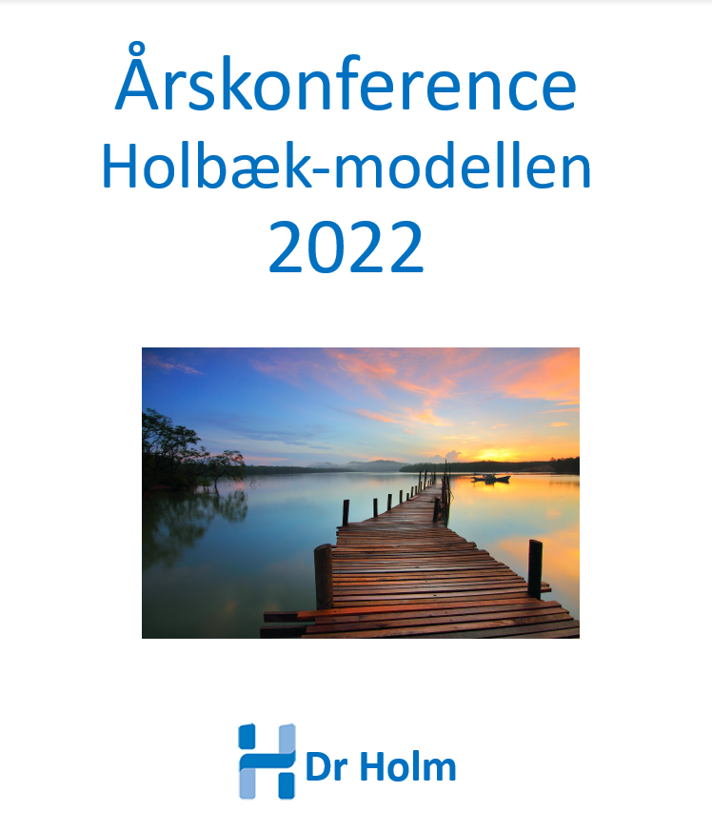

Slide 2

Introduktion af nye typer af medicin
til behandling af overvægt
Jens-Christian Holm
Head Consultant in Paediatrics, PhD, Associate Clinical and Research Professor,
Head of Research and The Children’s Obesity Clinic,
European Centre of Management (COM)
and
The HOLBAEK Study
Department of Paediatrics
Copenhagen University Hospital Holbæk, Denmark
and
The Novo Nordisk Foundation Center for Basic Metabolic Research, University of Copenhagen, Denmark
Co-chair of The Childhood Obesity Task Force (EASO)
Årskonference Holbæk-modellen 2022
Hotel Nyborg Strand

Slide 4
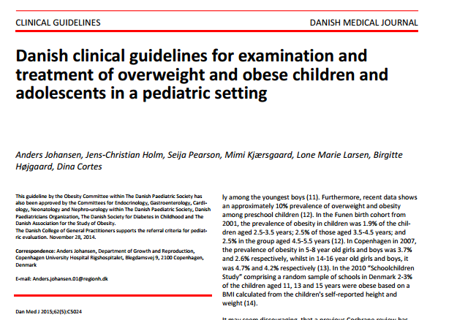

Slide 5
Comprehensive chronic care providing efficient results including:
Multidisciplinary management, including digital services
AOMs
Bariatric surgery

Slide 6
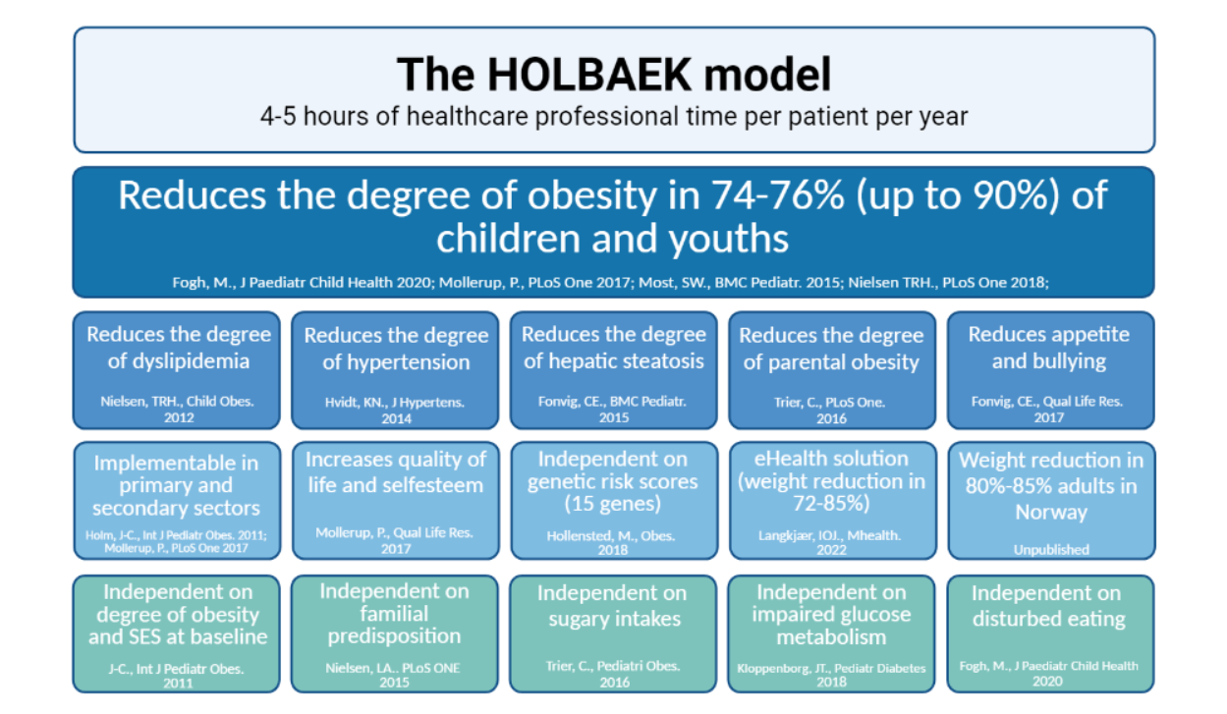

Slide 7
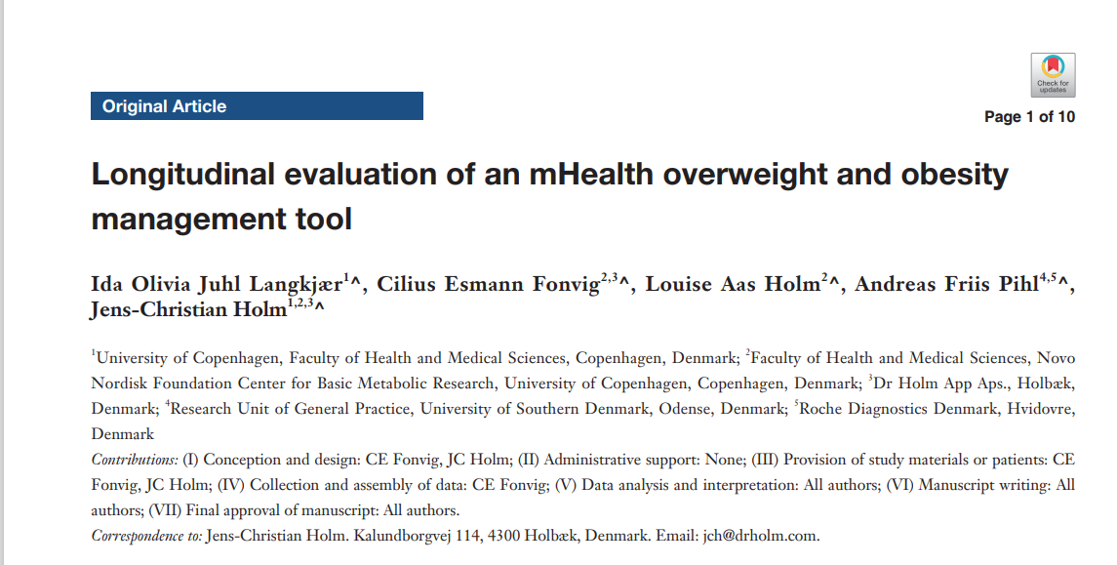

Slide 8
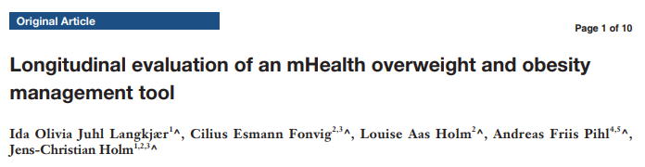
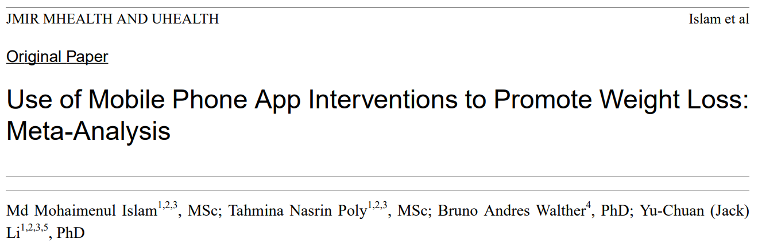
Resultater
Results
www.DrHolmApp.dk
www.DrHolmApp.com
www.DrHolmApp.net
www.DrHolmApp.info
 | DrHolmApp.dk (aug. 2021) | Meta-analyse 2020
Participants N | 940 | 792 (12 studier)
Gender | ♀ ~92% | ♀ ~92%
BMI difference | –0.63 (95% CI: –0.70 to –0.57, P<0.001) | −0.45 (95%CI: −0.78 to −0.12, P=.008)
Change in physical activity | 1.5 d/uge, P<0.001 | Ingen ændring, P=.88

Slide 9
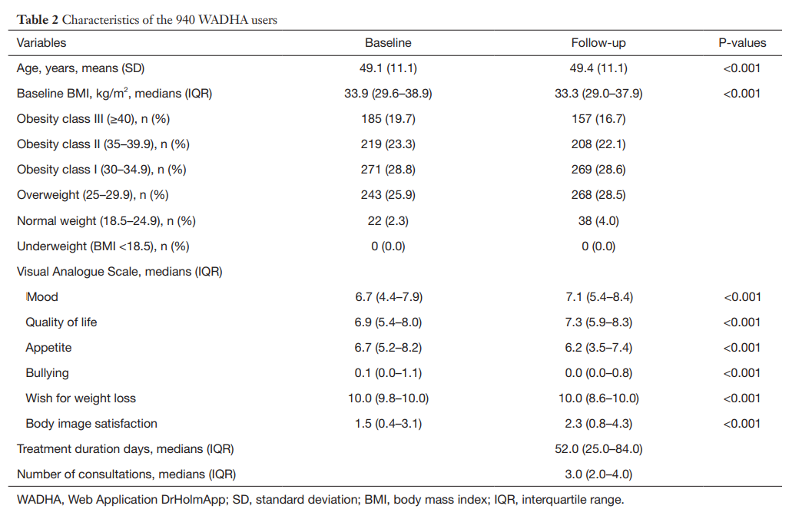
Results
www.DrHolmApp.dk
www.DrHolmApp.com
www.DrHolmApp.net
www.DrHolmApp.info
Exactly as results seen in children and adolescnts

Slide 10
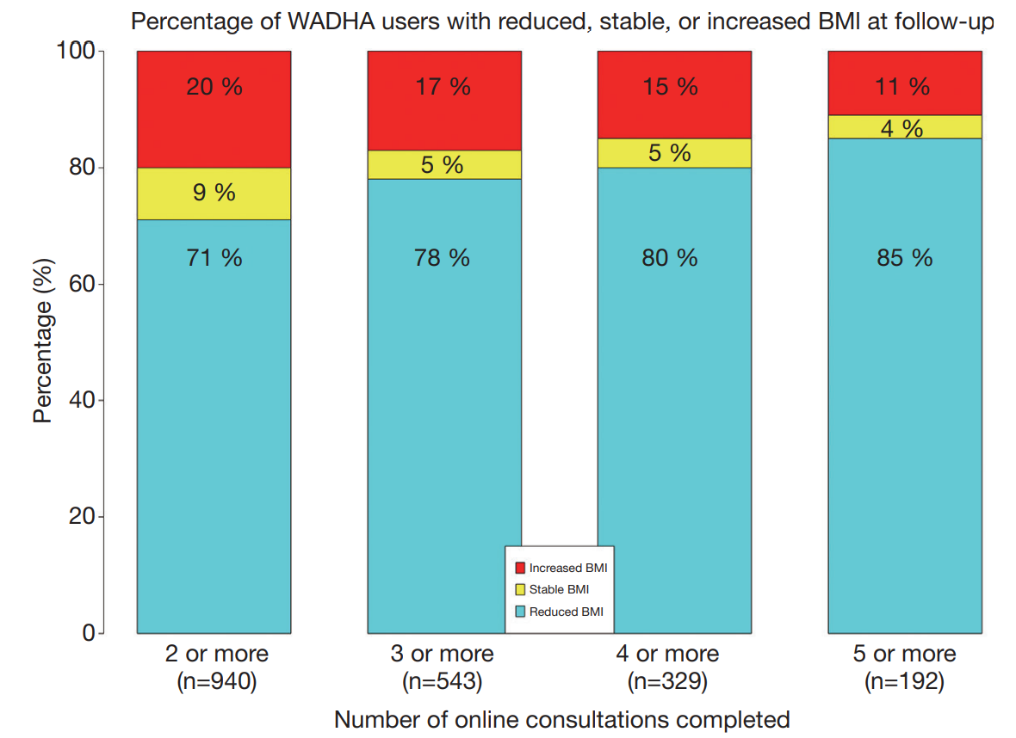
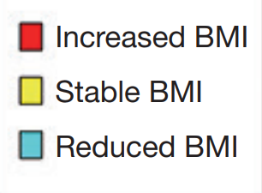
Results
www.DrHolmApp.dk
www.DrHolmApp.com
www.DrHolmApp.net
www.DrHolmApp.info
Private use
Smartphone
Tablet
PC/laptop
No contacts to hcps

Slide 11
AOMs
Metformin
Liraglutide
Semaglutide
Tirzapetide
Sethmelanotide

Slide 12
Metformin
et peroralt antidiabetikum i biguanidklassen. Stoffet er førstevalg til behandling af type 2 diabetes mellitus, specielt hos overvægtige personer og personer med normal nyrefunktion.
Metformin virker primært ved at hæmme produktionen af glukose i leveren. Derudover øger stoffet følsomheden overfor hormonet insulin, øger optagelsen af glukose i vævene, øger fedtsyre oxidationen, samt sænker optagelsen af glukose i mavetarmkanalen.

Slide 13
Glucagon-like peptid-1 receptor agonister
er agonister til GLP-1 receptoren. Disse medikamenter anvendes til behandling af af type 2 diabetes^{[1][2]} De er også godkendt til behandling af svær overvægt. En af fordelene i forhold til ældre insulin stimulatorer såsom sulfonylureas eller meglitinide agenter, er at de medfører en lavere risiko for udvikling af lavt blodsukker. GLP-1 agonister har en kort virkningsvarighed, hvorfor man har udført en række molekylære modifikationer for netop at forlænge virkningsvarigheden.
En 2021 meta-analyse viste en 12% reduktion i alle årsager dødelighed når GLP-1 analoger anvendes til behandling af type 2 diabetes, samt signifikante forbedringer I kardiovaskulær og nyre outcomes. En meta-analysis fra 2018 viste at GLP-1 agonister var associeret med lavere stroke risiko sammenlignet med controller. Tidlige studier viste en mulighed for udvikling af pancreatitis and pancreas cancer, men studier i mennesker har ikke fundet en øget risiko af pancreatitis, men er ikke tilstrækkelig store til at udelukke en øget forekomst af pancreas cancer.

Slide 14
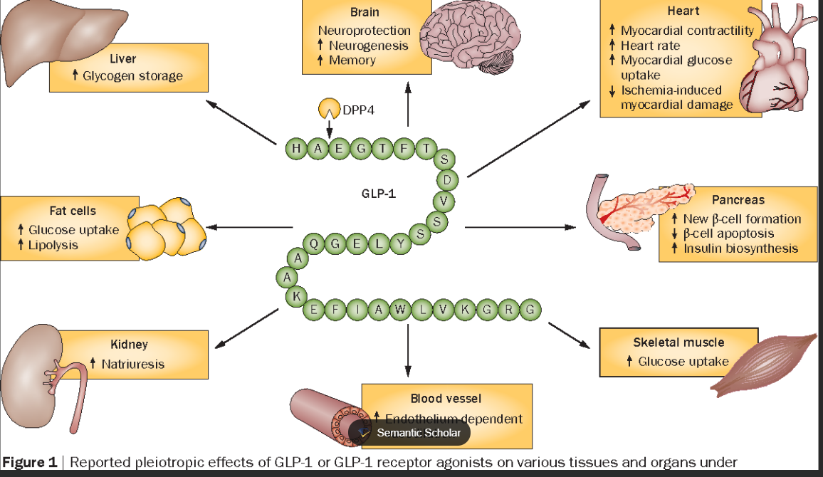

Slide 15
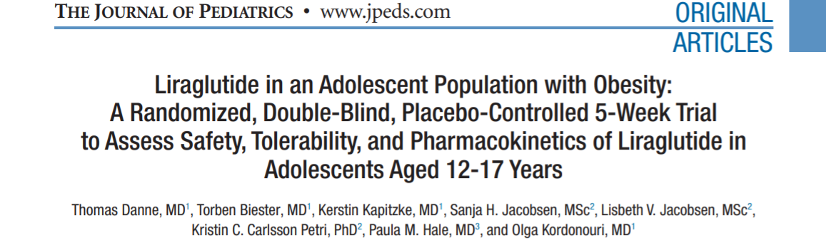
Conclusions Liraglutide had a similar safety and tolerability profile compared with
adults when administered to adolescents with obesity, with no unexpected
safety/tolerability issues. Results suggest that the dosing regimen approved
for weight management in adults may be appropriate for use in adolescents.
(J Pediatr 2016;■■:■■-■■). Trial registration ClinicalTrials.gov: NCT01789086.

Slide 16
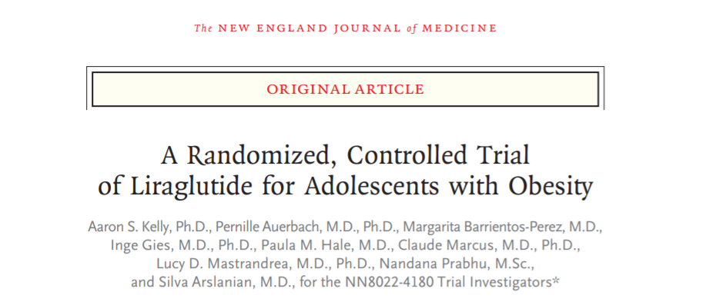
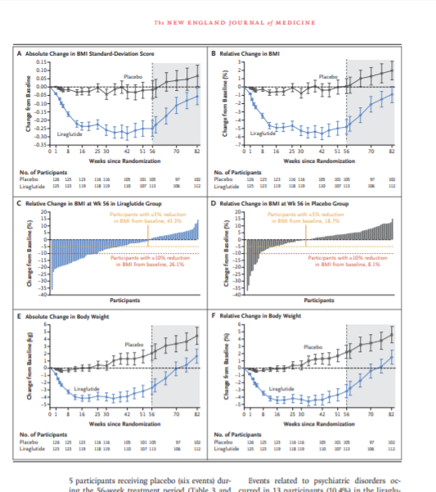
COUNSELING IN HEALTH NUTRITION AND PHYSICAL ACTIVITY
Participants received individualized counseling in healthy nutrition that was performed by a certified dietician and evaluated at every visit using a numerical rating scale.
Participants received individualized counseling in physical activity at every visit that was performed by site staff trained in physical activity counseling. Participants were encouraged to engage in 60 minutes of moderate- to high-intensity physical activity daily.
This article was published on March 31, 2020,
at NEJM.org. DOI: 10.1056/NEJMoa1916038

Slide 17
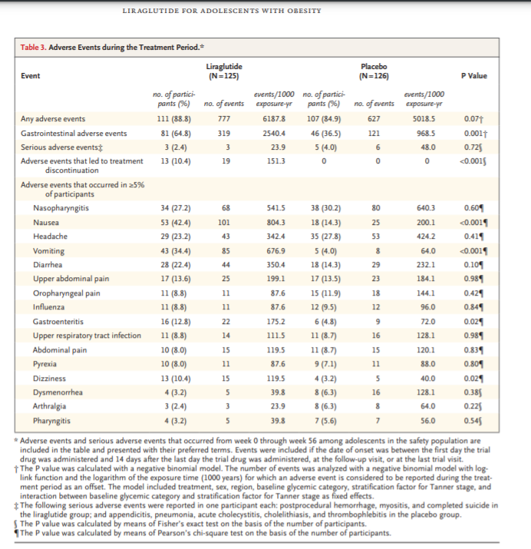

Slide 18
Indications
12-17 years
Iso BMI of 30, and or related complications
Poor response to lifestyle alone
Adjunct to obesity management!
Identify those in need!
Safety and side effects!
Duration and cost!
Treatment effect after termination of GLP-1!

Slide 19
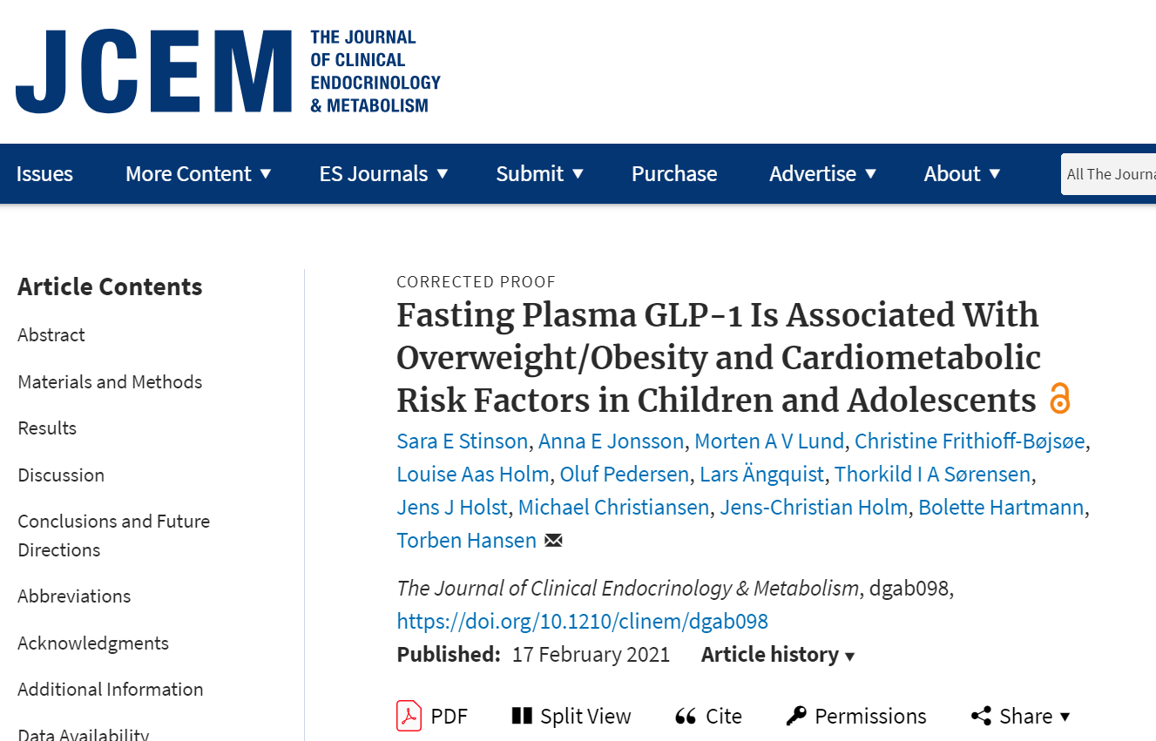
Conclusion
Overweight/obesity in children and adolescents is associated with
increased fasting plasma total GLP-1 concentrations, which was
predictive of higher CMR factors.

Slide 20
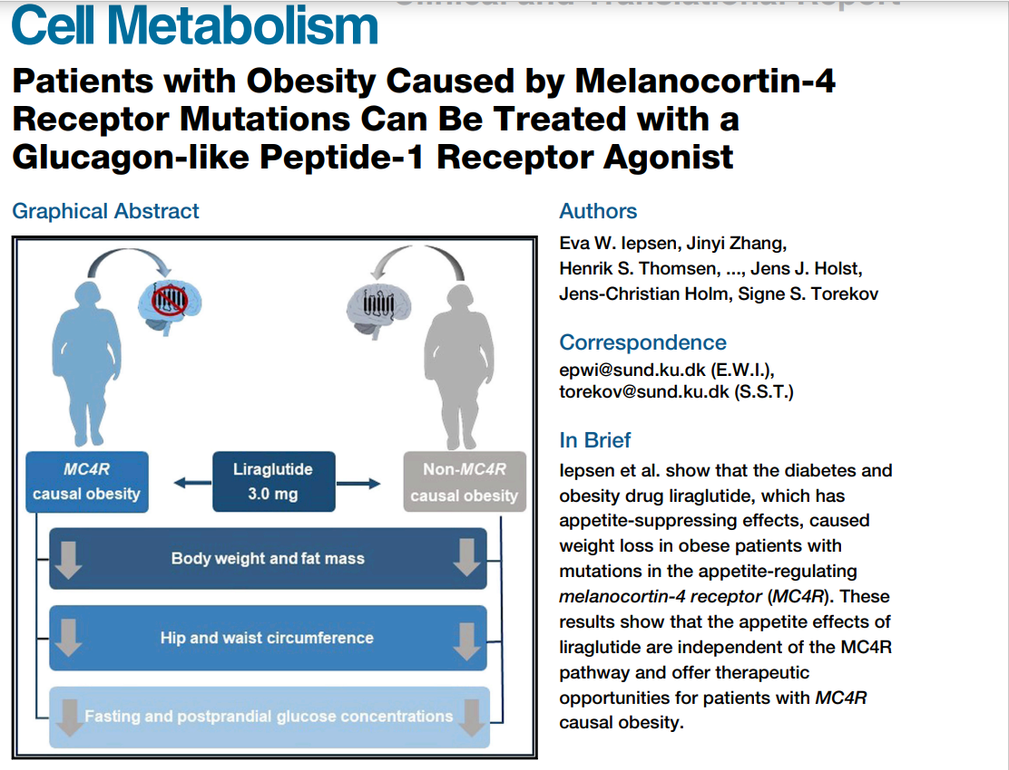
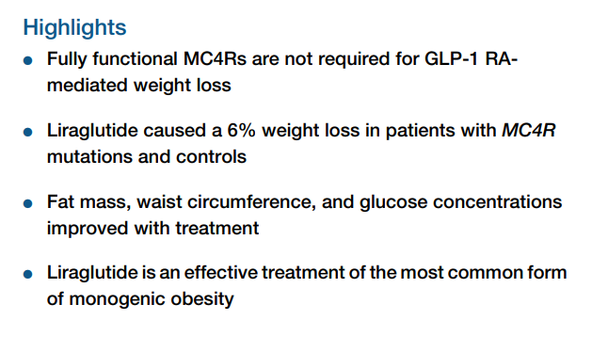

Slide 21
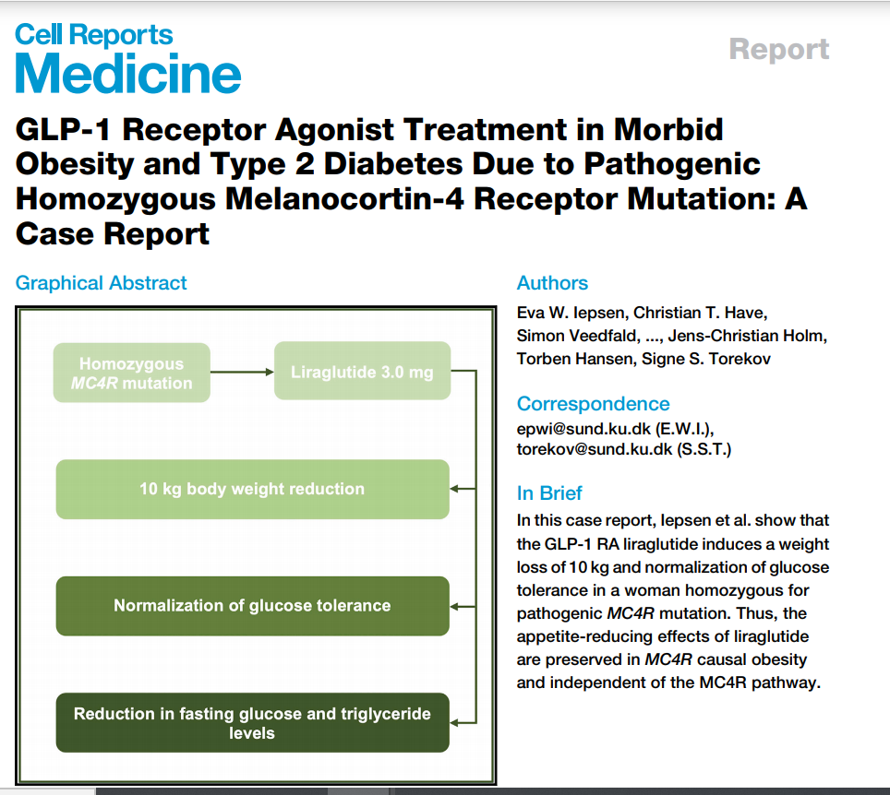
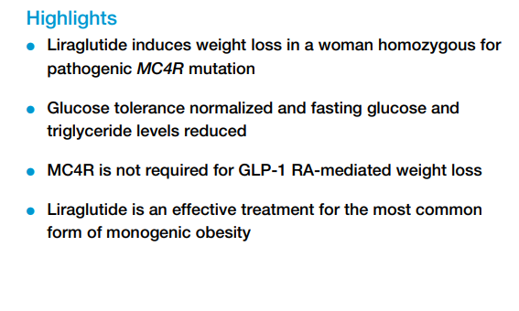

Slide 22
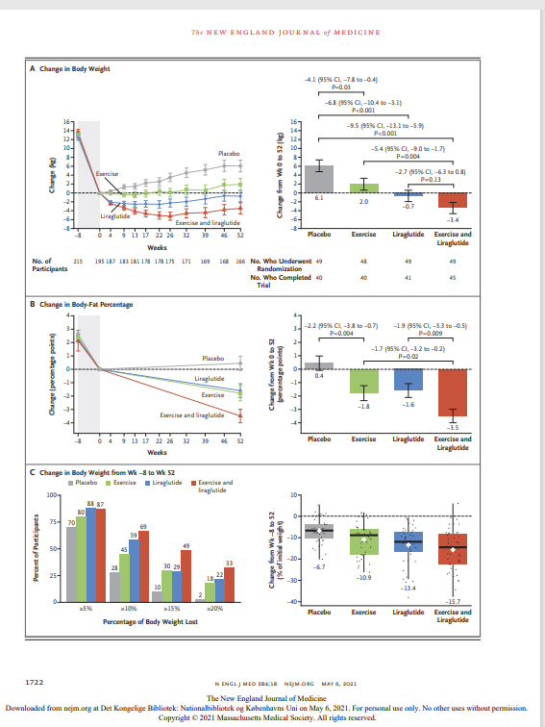
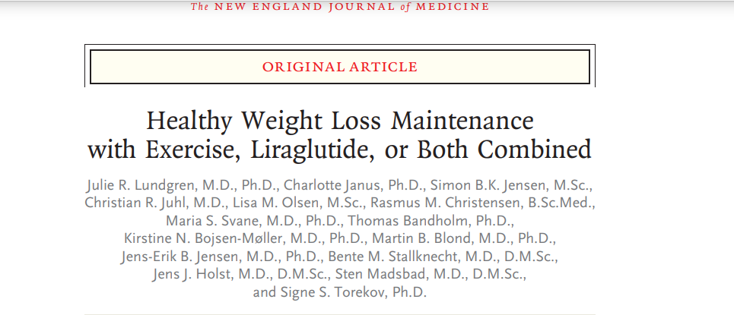
CONCLUSIONS A strategy combining exercise and liraglutide
therapy improved healthy weight loss maintenance more than
either treatment alone.
N Engl J Med 2021;384:1719-30.
DOI: 10.1056/NEJMoa2028198

Slide 23
Tirzepatide
Er et medikament der anvendes til behandling af type 2 diabetes.Tirzepatide gives ugentlig subkutant.
Almindelige bivirkninger kan være kvalme, opkastninger, diarre, forstoppelse, øvre mavesmerter og mavesmerter.
Glucagon-like peptide-1 (GLP-1) og den glukose-afhængige insulinotropic polypeptide (GIP) er et hormon der er involveret i blodsukker regulationen. Efter en person har spist, frigives disse hormone fra tarmens celler hvorefter der frigives insulin.
Tirzepatide er en GIP-analog som aktiverer både GLP-1 og GIP receptorer, der medfører en forbedret blood sukker control. Tirzepatide blev godkendt til anvendelse i USA i Maj 2022.

Slide 24
Efficacy and safety of Tirzepatide, a novel glucose-dependent insulinotropic polypeptide and glucagon-like peptide-1 receptor agonist, in people with obesity are not known
3 double-blind, randomized, controlled trial, we assigned 2.539 adults with a body-mass index (BMI; the weight in kilograms divided by the square of the height in meters) of 30 or more, or 27 or more and at least one weight-related complication, excluding diabetes, in a 1:1:1:1 ratio to receive once-weekly, subcutaneous tirzepatide (5 mg, 10 mg, or 15 mg) or placebo for 72 weeks, including a 20-week dose-escalation period.
At baseline, the mean body weight was 104.8 kg, the mean BMI was 38.0, and 94.5% of participants had a BMI of 30 or higher. The mean percentage change in weight at week 72 was −15.0% (95% confidence interval [CI], −15.9 to −14.2) with 5-mg weekly doses of tirzepatide, −19.5% (95% CI, −20.4 to −18.5) with 10-mg doses, and −20.9% (95% CI, −21.8 to −19.9) with 15-mg doses and −3.1% (95% CI, −4.3 to −1.9) with placebo (P<0.001 for all comparisons with placebo). The percentage of participants who had weight reduction of 5% or more was 85% (95% CI, 82 to 89), 89% (95% CI, 86 to 92), and 91% (95% CI, 88 to 94) with 5 mg, 10 mg, and 15 mg of tirzepatide, respectively, and 35% (95% CI, 30 to 39) with placebo; 50% (95% CI, 46 to 54) and 57% (95% CI, 53 to 61) of participants in the 10-mg and 15-mg groups had a reduction in body weight of 20% or more, as compared with 3% (95% CI, 1 to 5) in the placebo group (P<0.001 for all comparisons with placebo). Improvements in all prespecified cardiometabolic measures were observed with tirzepatide. The most common adverse events with tirzepatide were gastrointestinal, and most were mild to moderate in severity, occurring primarily during dose escalation. Adverse events caused treatment discontinuation in 4.3%, 7.1%, 6.2%, and 2.6% of participants receiving 5-mg, 10-mg, and 15-mg tirzepatide doses and placebo, respectively.
In this 72-week trial in participants with obesity, 5 mg, 10 mg, or 15 mg of tirzepatide once weekly provided substantial and sustained reductions in body weight.

Slide 25
Sethmelanotide
Er et medikament der anvendes til svær overvægt der skyldtes sjældne enkeltårsags genetiske mutationer.
De mest almindelige bivirkninger omfatter injektionssteds reaktioner som hud hyperpigmentering, hovedpine samt gastroentologiske gener (kvalme, diarre, mavesmerter).
Depression og selvmordstanker har fundet sted ved anvendelse med setmelanotide.
Setmelanotide blev godkendt til medicinsk behandling i USA i November 2020 og i den Europæiske Union i 2021.[
Setmelanotide er indiceret ved kronisk behandling af overvægt (vægttab og vægtvedligeholdelse i mindst et år) i børn fra 6 års alderen med svær overvægt der skyldtes sjældne genetiske årsager til svær overvægt såsom pro-opiomelanocortin (POMC) mangel, proprotein subtilisin/kexin type 1 (PCSK1) mangel, og leptin receptor (LEPR) mangel bekræftet med genetisk testning der demonstrerer varianter i POMC, PCSK1, or LEPR generne der anses for at være sygdomsfremkaldende.
Setmelanotide er den første godkendte medikament af FDA til behandling af sjældne enkeltårsags genetiske årsager til svær overvægt.

Slide 26
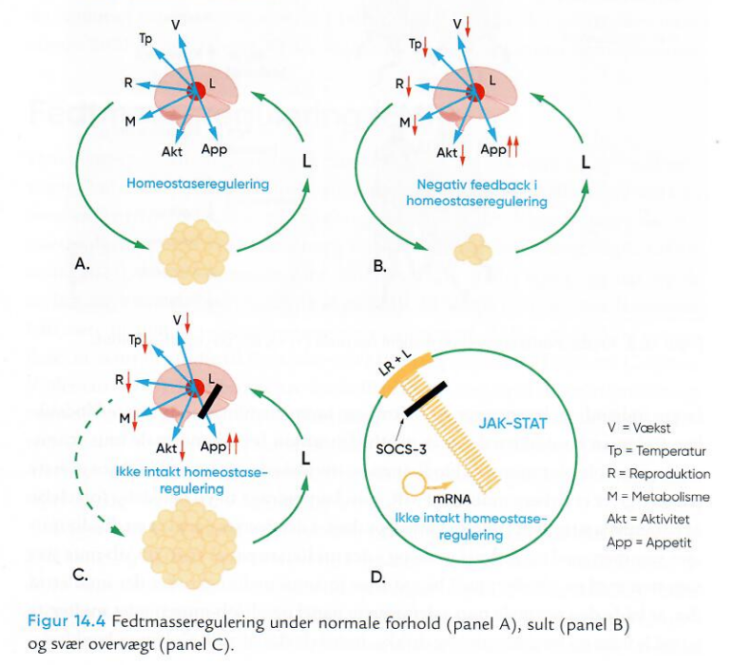

Slide 27
Fat mass (energy) regulation
Expected treatment heterogeneity (i.e., treatment responses)
Outcomes
Poor
Intermediate
Better towards excellent
Causes of response heterogeneity:
Biological: genes, neuroendocrine regulation, etc.
Psychosocial: SES, safety, neglect, abuse, etc.
Body composition
BMI SDS, BMI and fat mass
Treatment time
BMI, body mass index; SDS, standard deviation scores; SES, socioeconomic status.

Slide 28
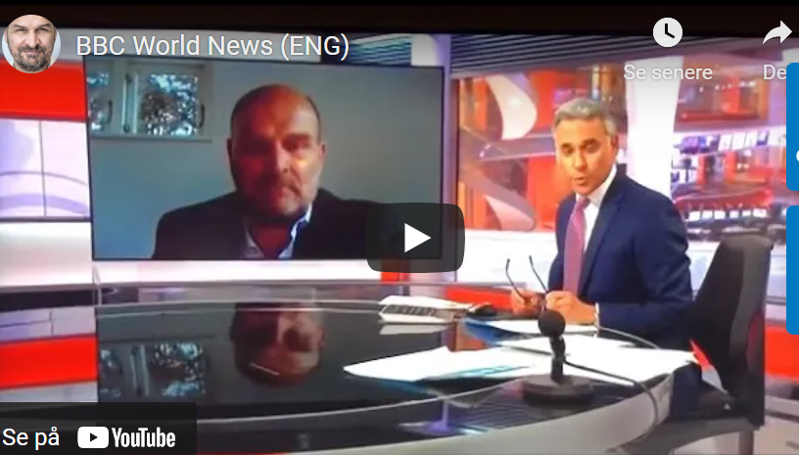

Slide 29

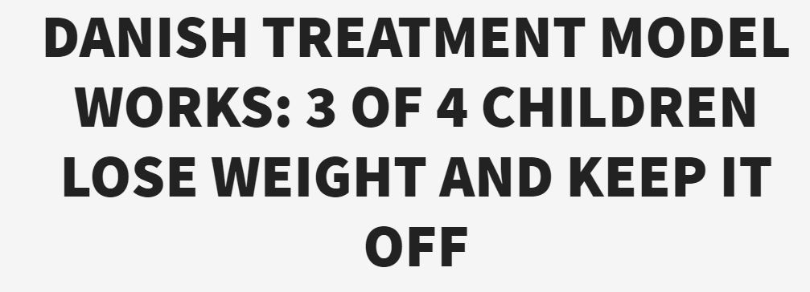

Slide 30


Sundhedsspil
Sjov og Sund med Doktor Holm

Slide 31
Mange tak for opmærksomheden
Mail jhom@regionsjaelland.dk and jch@drholm.com
LinkedIn Jens-Christian Holm
Orcid 0000-0003-4653-342X
Facebook Jens-Christian Holm
Instagram JensChristianHolm
Twitter JC_Holm
Homepage www.jenschristianholm.dk/uk/

