Slide 1
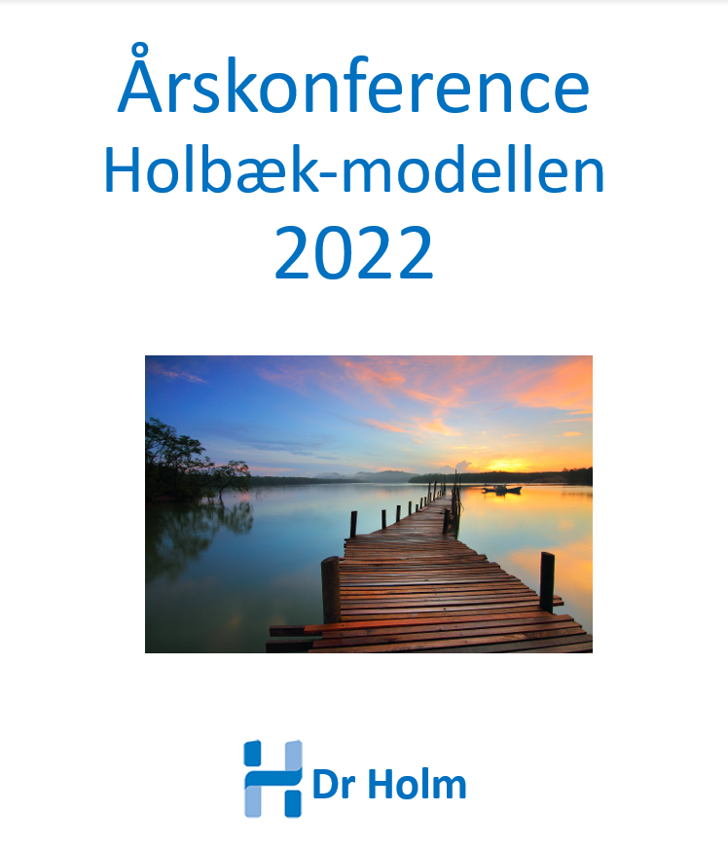

Slide 2

Neuroendokrin adaptation mod vægttab
Jens-Christian Holm
Head Consultant in Paediatrics, PhD, Associate Clinical and Research Professor,
Head of Research and The Children’s Obesity Clinic,
European Centre of Management (COM)
and
The HOLBAEK Study
Department of Paediatrics
Copenhagen University Hospital Holbæk, Denmark
and
The Novo Nordisk Foundation Center for Basic Metabolic Research, University of Copenhagen, Denmark
Co-chair of The Childhood Obesity Task Force (EASO)
Årskonference Holbæk-modellen 2022
Hotel Nyborg Strand

Slide 4
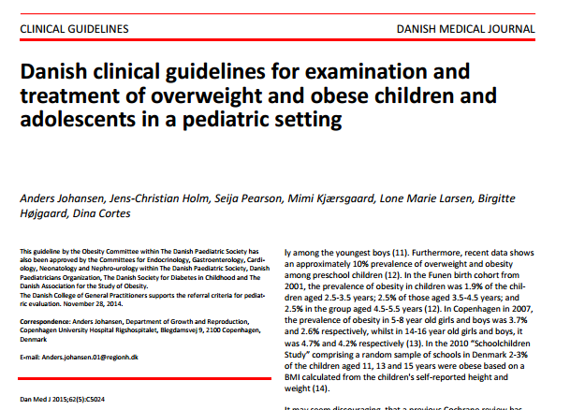

Slide 5
Paediatricians secure optimal growth, development and thriving
Milestones
Secure optimal growth and development and optimal physical, mental and social thriving.
Height velocity
Body composition
Expected target height
Health
Growth and development
Time

Slide 6
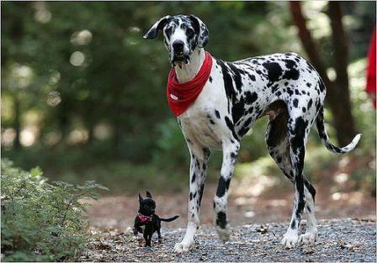
Vækst og udvikling er mange ting !

Slide 7
Take Home Message
Vækst kurven – dit bedste redskab

Slide 8
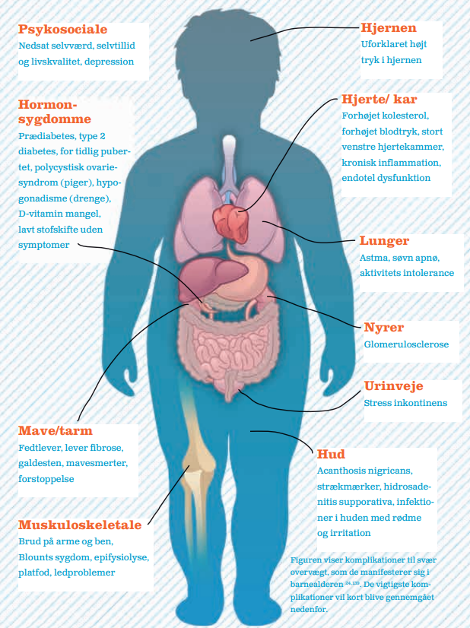
Complications to overweight
Agenda
The HOLBAEK Study
The Cohorts
Complications
Treatment effect
Reference values
Genetics
Early growth
Impact
Future
Take home message
Psychosocial
Improvements during treatment: QoL, bullying, appetite, body perception
Brain
Disturbed eating behavior
Endocrinology
Prediabetes
Vitamin D insufficiency
Subclinical hypo-thyroidism
Reference values of overweight-related biomarkers
Cardiovascular
Prehypertension
Hypertension
Dyslipidemia
75% with low self-esteem, self-confidence or quality of life
82% with disturbed eating
50% with hypertension or prehypertension
28% with dyslipidemia
60% with vitamin-D insufficiency
14% with prediabetes
45% with sleep apnea
31% with hepatic steatosis
Lungs
Sleep apnea
Genetics
6 new overweight-related genes discovered
Kidneys
Glomerulosclerosis
Urinary tract
Oxidative stress biomarkers
Gastrointestinal
Hepatic steatosis
Skin
Hidradenitis suppurativa
Acanthosis nigricans
Striae distensae
Acne
Fogh, J Paediatr Child Health. 2020; 56(4):542-549
Mollerup, J Hum Hypertens. 2017;31(10):640-646
Nielsen, BMC Pediatr. 2017 Apr 28;17(1):116
Plesner, J Pediatr Endocrinol Metab. 2018;26;31(1):53-61
Kloppenborg, Pediatr Diabetes. 2018 May;19(3):356-365
Andersen, Eur Arch Otorhinolaryngol. 2019 Mar;276(3):871-878
Fonvig, PLoS One. 2015 Aug 7;10(8):e0135018
Musculoskeletal
Muscular steatosis (68%)
(Courtesy of Dr Holm)
Notes:
Cross-sectional studie from the Holbaek study with around the 4000 participants.
Among children and adolescents with overweight and obesity…
75% has low self-esteem, self-confidence and quality of life
82% has disturbed eating
50% has hypertension or prehypertension
60% has vitamin D insufficiency
14% has prediabetes
45% has sleep apnea
And 231% has hepatic steatosis
Tjek: fogh’s paper om det også er inkl. QoL?

Slide 9
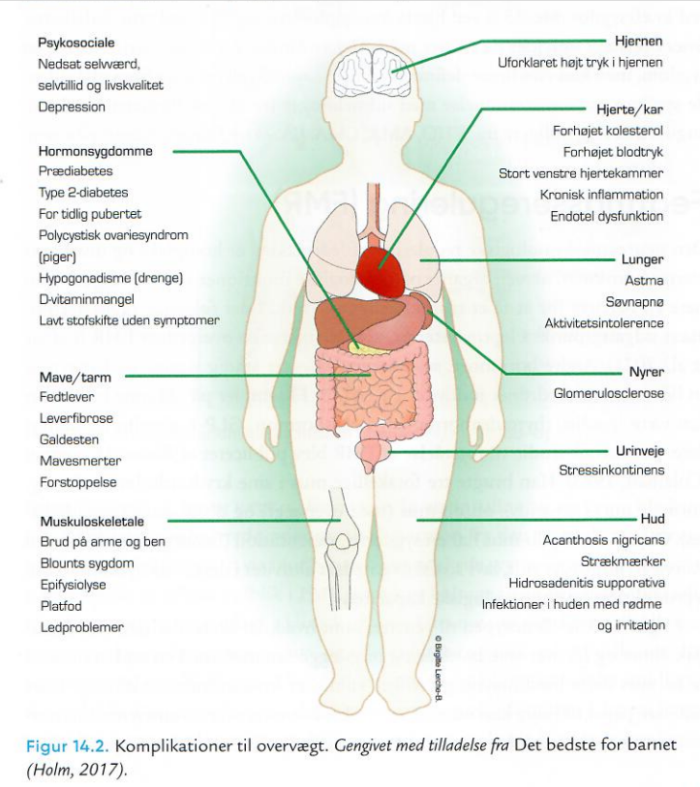

Slide 10
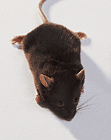
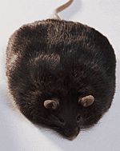

Slide 11
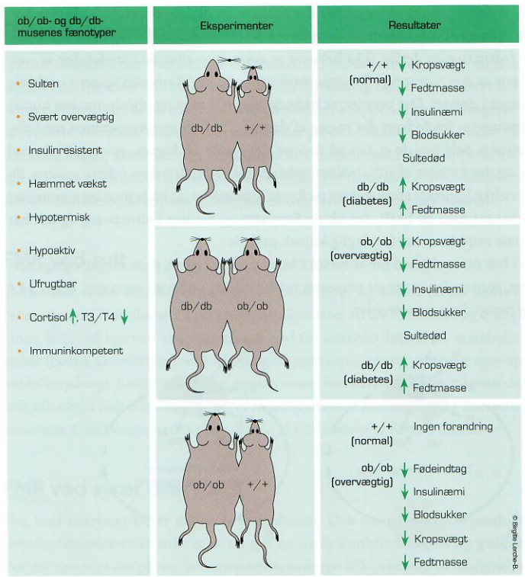

Slide 12
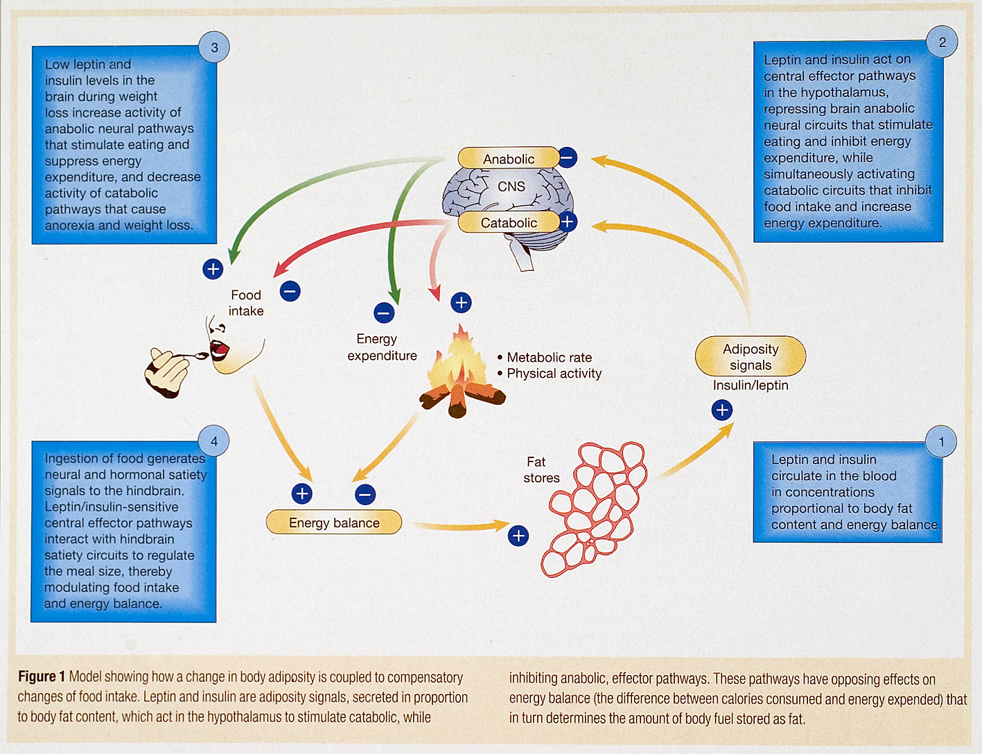
Notes:
12

Slide 13
Li X et al. Obesity 2010; 18(3):456-62.
Fat mass
Mice receiving 5% less food
Mice receiving food = need
1 21 days

Slide 14
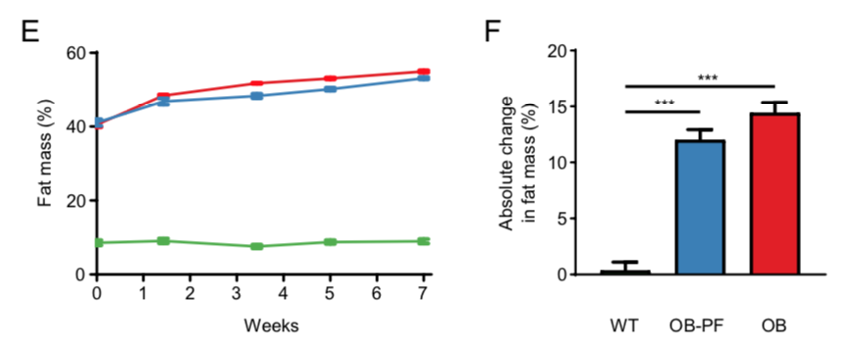
Impaired glucose metabolism and altered gut microbiome despite calorie restriction of ob/ob mice
Pair-fed ob/ob mice exhibited even more compromised glucose metabolism and maintained strikingly similar high body fat percentage at the cost of lean body mass.
A Kashani, AD Brejnrod, C Jin, T Kern, AN Madsen, LA Holm, GK Gerber, JC Holm, T Hansen, B Holst, M Arumugam Animal Microbiome; 2019
Notes:
Abstract
Background: Growing evidence supports the role of gut microbiota in obesity and its related disorders including type 2 diabetes. Ob/ob mice, which are hyperphagic due to leptin deficiency, are commonly used models of obesity and were instrumental in suggesting links between gut microbiota and obesity. Specific changes in their gut microbiota such as decreased microbial diversity and increased Firmicutes to Bacteroidetes ratio have been suggested to contribute to obesity via increased microbiota capacity to harvest energy. However, the differential development of ob/ob mouse gut microbiota compared to wild type microbiota and the role of hyperphagia in their metabolic impairment have not been investigated thoroughly.
Results: We performed a 10-week long study in ob/ob (n=12) and wild type control (n=12) mice fed ad libitum. To differentiate effects of leptin deficiency from hyperphagia, we pair-fed an additional group of ob/ob mice (n=11) based on the food consumption of control mice. Compared to control mice, ob/ob mice fed ad libitum exhibited compromised glucose metabolism and increased body fat percentage. Pair-fed ob/ob mice exhibited even more compromised glucose metabolism and maintained strikingly similar high body fat percentage at the cost of lean body mass. Acclimatization of the microbiota to our facility took up to 5 weeks. Leptin deficiency impacted gut microbial composition, explaining 18.3% of the variance. Pair-feeding also altered several taxa, although the overall community composition at the end of the study was not significantly different. We found 24 microbial taxa associations with leptin deficiency, notably enrichment of members of Lactobacillus and depletion of Akkermansia muciniphila. Microbial metabolic functions related to energy harvest, including glycan degradation, phosphotransferase systems and ABC transporters, were enriched in the ob/ob mice. Taxa previously reported as relevant for obesity were associated with body weight, including Oscillibacter and Alistipes (both negatively correlated) and Prevotella (positively correlated).
Conclusions: Leptin deficiency caused major changes in the mouse gut microbiota composition. Several microbial taxa were associated with body composition. Pair-fed mice maintained a pre-set high proportion of body fat despite reduced calorie intake, and exhibited more compromised glucose metabolism, with major implications for treatment options for genetically obese individuals.

Slide 15
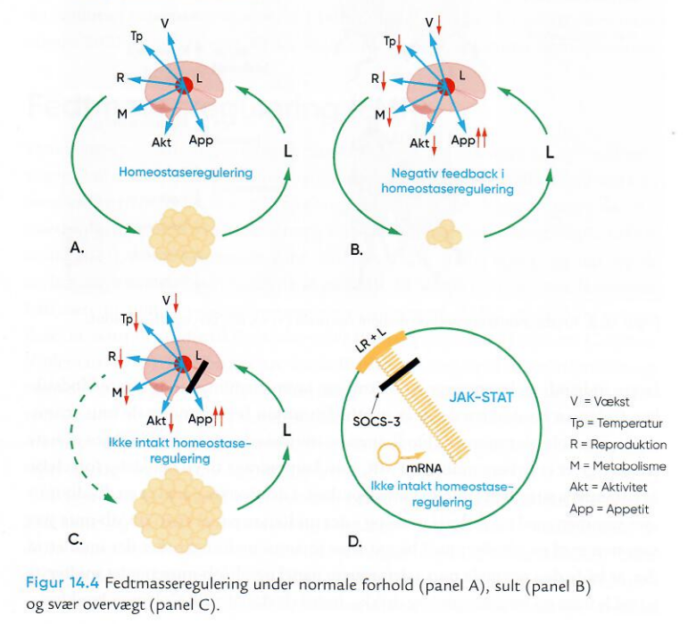

Slide 16
Fat mass (energy) regulation
Expected treatment heterogeneity (i.e., treatment responses)
Outcomes
Poor
Intermediate
Better towards excellent
Causes of response heterogeneity:
Biological: genes, neuroendocrine regulation, etc.
Psychosocial: SES, safety, neglect, abuse, etc.
Body composition
BMI SDS, BMI and fat mass
Treatment time
BMI, body mass index; SDS, standard deviation scores; SES, socioeconomic status.

Slide 17
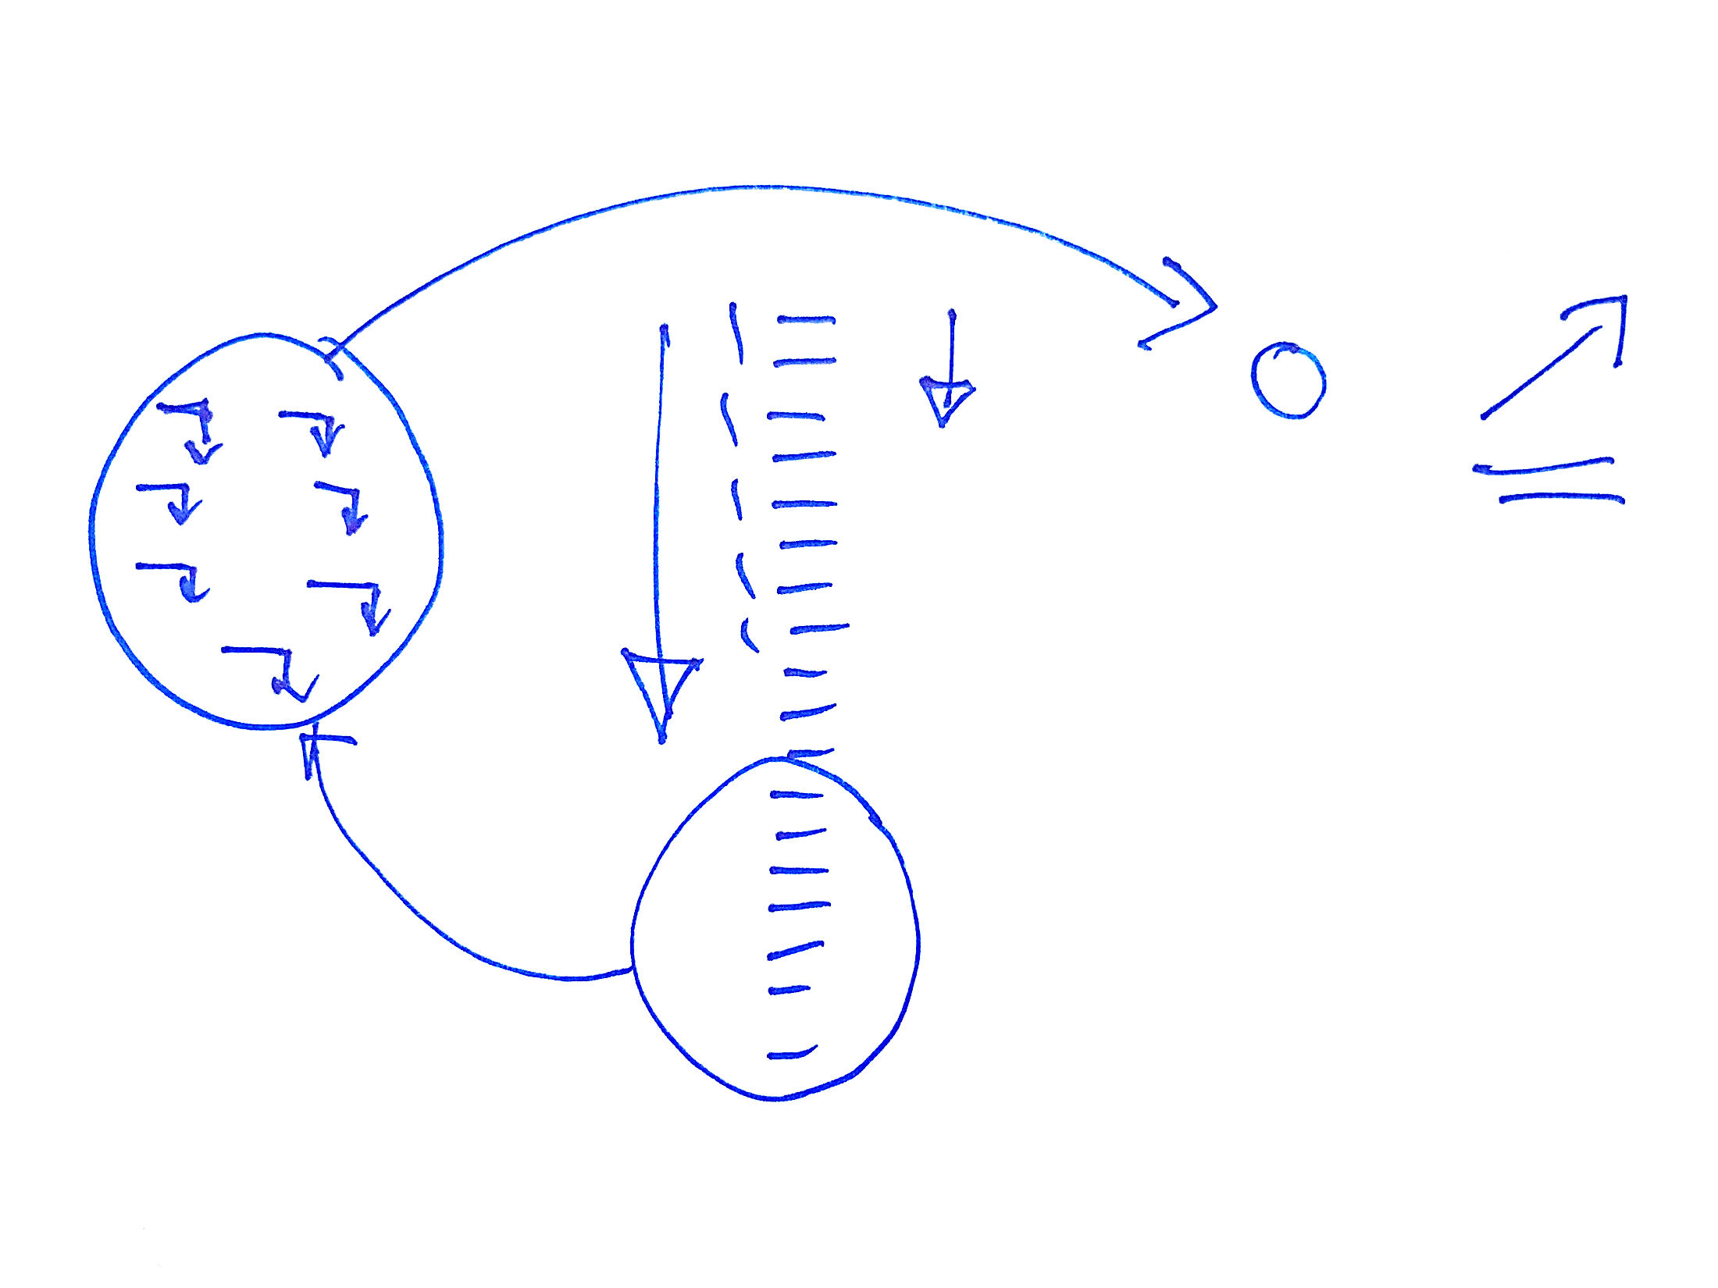

Slide 18

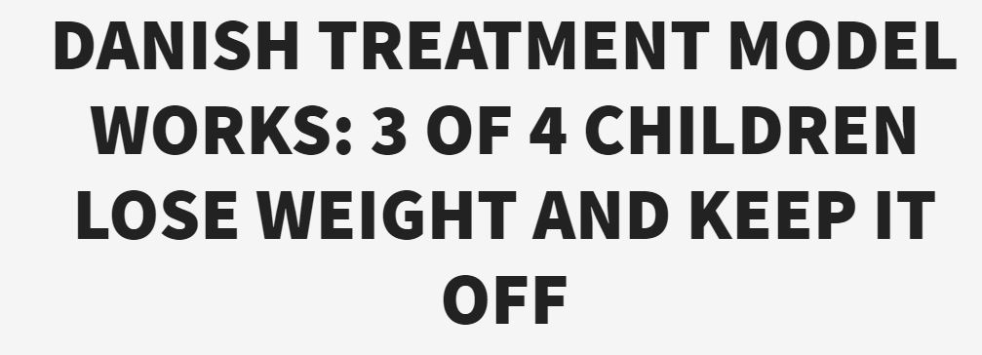

Slide 19
Mange tak for opmærksomheden
Mail jhom@regionsjaelland.dk and jch@drholm.com
LinkedIn Jens-Christian Holm
Orcid 0000-0003-4653-342X
Facebook Jens-Christian Holm
Instagram JensChristianHolm
Twitter JC_Holm
Homepage www.jenschristianholm.dk/uk/

